Slide 1
AI Resume Analyzer
CAPSTONE PROJECT
Presented By:
Student Name- HARSHALA RAJENDRA SURWADE
College Name- Hindi Seva Mandal Shri Sant Gadge Baba College of Engineering and Technology Bhusawal
Department- CSE ( Data Science)

Slide 2
OUTLINE
Problem Statement
Proposed System/Solution
System Development Approach (Technology Used)
Algorithm & Deployment
Result
Conclusion
Future Scope
References

Slide 3
Problem Statement
Manual resume reviews are slow and inconsistent
Students and freshers find it difficult to evaluate resume quality
Lack of awareness about job-specific requirements
Limited knowledge of ATS filtering systems
Difficulty in identifying resume improvement areas
.

Slide 4
Proposed Solution
Upload resume in PDF format
Automatically checks if document is a resume
Analyzes resume for selected job role
AI-based Resume Analyzer web application
Provides structured feedback and ATS score

Slide 5
System Approach
Python for backend processing
Streamlit for web-based user interface
PyPDF2 for PDF text extraction
Groq API for AI model access
LLaMA 3.1 Large Language Model
dotenv for secure API key handling

Slide 6
Algorithm & Deployment
Algorithm Steps:
Upload PDF resume
Extract text from PDF
Classify document using AI
Analyze resume for job role
Generate feedback and ATS score
Deployment:
Streamlit web application
Can be deployed locally or on cloud

Slide 7
Result
Accurate resume identification
Instant AI-generated feedback
Job-specific resume analysis
ATS score with explanation
Downloadable feedback report

Slide 8
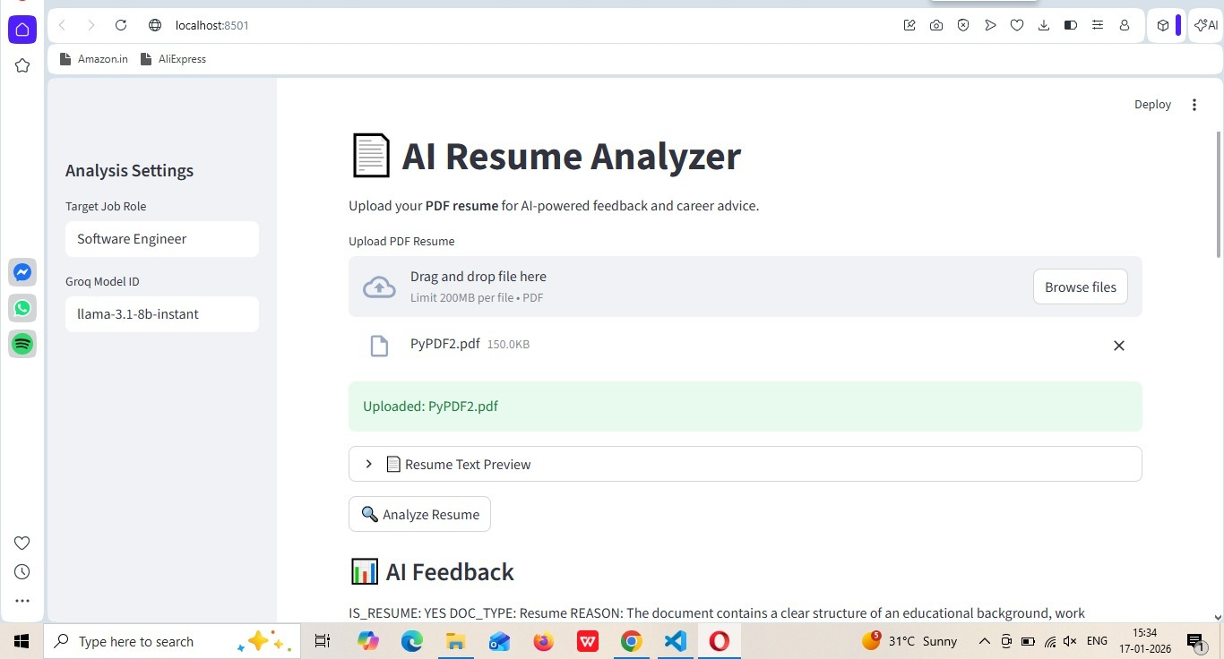
Conclusion

Slide 9
Future scope
Multi-language resume support
Support for DOCX and other formats
Resume vs job description matching
Interview preparation assistance
Skill gap analysis
.

Slide 10
References
Streamlit Documentation: https://docs.streamlit.io/.
PyPDF2 Documentation: https://pypdf2.readthedocs.io/
Groq API Documentation: https://console.groq.com/docs
LLaMA Large Language Model (Meta AI): https://ai.meta.com/llama/

Slide 11
Github link
Github Link : https://github.com/harshalasurwade-dot/Ai-Resume-Analyzer.git

Slide 12
THANK YOU

